Slide 1

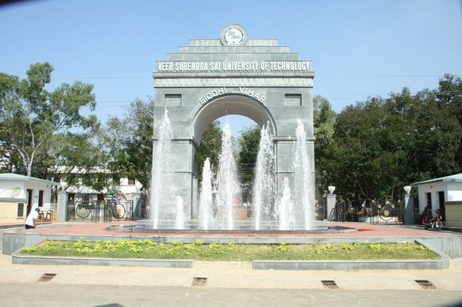
About the Department
TEQIP –III Sponsored One Day Workshop On
Professional Skills
26th Nov 2017
The Department of Computer Science and Engineering, Veer Surendra Sai University of Technology (Formerly University College of Engineering: Burla, Estd-1956), was established in 1994 and at present offers the following four years undergraduate programmes, two years Master Degree programmes and Doctoral Degree. It has produced high quality technocrats for the last few decades to cater to the needs of hardware and software industry, R&D organizations, and academic Institutions. The department has been accredited for 3 years since 2016 by NBA. The syllabi of the Department are updated with many advanced courses to enable students to keep themselves at par with the cutting edge-technology. The teaching in the department emphasizes on fundamental principles, development of creative thinking and the analytical ability to solve real life problems. The Department also encourages its students to engage in extra-curricular and co-curricular activities, personality development, developing team spirit, and developing organizational skills.
About the Institute
Veer Surendra Sai University of Technology (VSSUT), Burla was formed by Odisha Act 9 of 2009 by converting University College of Engineering (UCE), Burla to a non-affiliating Unitary State University and came into force from 1st day of July 2009. The University has eleven departments covering all the major engineering, science and humanities disciplines, offering B. Tech, B. Arch, M. Tech, M. Sc and Ph. D programmes. It is situated very close to one of the longest earthen dam in the world known as Hirakud Dam. Apart from VSSUT, several renowned educational institutions like Sambalpur University and VIMSAR exist in Burla, small town in the district of Sambalpur. Burla is not only a educational hub but also a industrial township in the western Odisha containing two reputed industries like MCL and HINDALCO. It is well connected by railway network to the rest of India via Sambalpur. The VSSUT campus is about 10 kms from Sambalpur railway station.
Organized by
Department of Computer Science and Engineering
Veer Surendra Sai University of Technology
Contact
Dr. Rakesh Mohanty, HOD, CSE
Dr. Santosh Kumar Majhi, Convener
Mr. Sujaya Kumar Sathua, Convener
Website: www.vssut.ac.in

Slide 2
Organizers
Registration Form
Patron
Prof. E. Saibaba Reddy, Vice Chancellor
Advisory Committee
Prof. P K Hota, Dean CDCE
Prof. S Panda, Coordinator, TEQIP-III
Prof. D Mishra, Dean Student Welfare
Prof. P K Kar, Dean Faculty and Planning
Prof. S K Swain, Dean PGSR
Prof. A N Nayak, Dean SRIC
Prof. P K Das, Dean Academics
Program Chair
Dr. Rakesh Mohanty, HOD CSE
Convener
Dr. Santosh Kumar Majhi
Mr. Sujaya Kumar Sathua
Organizing Committee
Prof. A K Rath
Dr. M R Kabat
Dr. S Panigrahi
Dr. S Das
Mr. S P Sahoo
Dr. S K Panda
Dr. S K Majhi
Mr. S Srichandan
Ms. S K Behera
Ms. A Dash
TEQIP-III
Sponsored
One Day Workshop on Professional Skills
November 26, 2017
Veer Surendra Sai University of Technology, Burla
Registration Form
NAME (in block letters) :
Highest Qualification :
Institute/Organization :
Department :
Designation for Faculty/Staff :
Correspondence Address :
Mobile Number :
Email :
Signature
Registration
The registration is free of cost. The filled application has to be submitted at office of Head, CSE on or before 24th Nov 2017.

